Slide 1
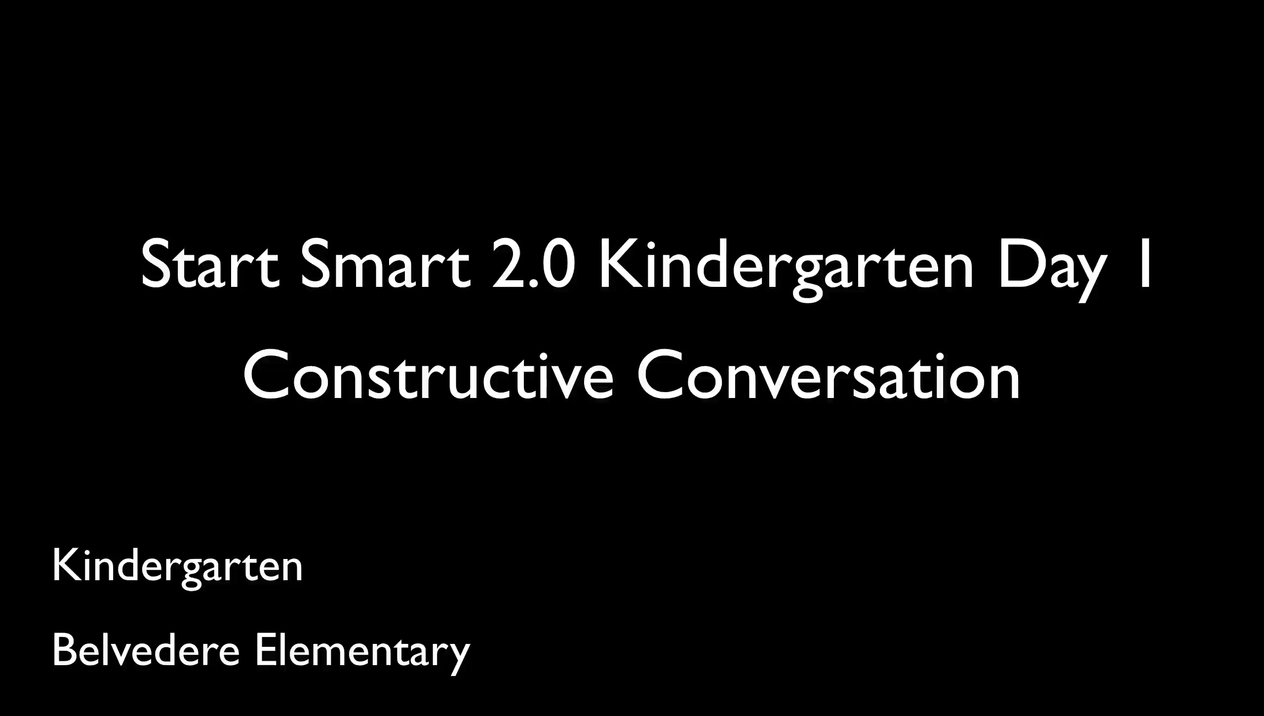
Start Smart 2.0 in Action
Notes:
5-7 minutes
You can use this video at the end as your last slide if time permit. They get to see Start Smart 2.0 in action in a kinder room. Let the participants know that they will get to hear students use the Conversation Pattern to Clarify through paraphrasing, building on and prompting.

